Slide 1
Energy efficient UDN design using reinforcement learning
DGIST
BongSang Kim
JaeHyun Lee
19/July/2019
UGRP Meeting

Slide 2
Progress
Design Env code
Design RL code – MCTS
Remodel based on sample library
Most of MCTS libraries are for sequential game
→ We decided to mcts.py module instead of using MCTS library
Make 2 module
main.py: UDNEnv(environment code)+MCTS(RL code)
ppp.py: BSposition.csv(information of BS position) create

Slide 3
System Model
Environment model
16-users and 10-BSs are deployed in the area
BS location is PPP
User location is uniform distribution which changes every step
전원 off 된 BS와 user까지의 거리를 infinity로 하여 association을 막음
MCTS model
Utilize MCTS library on Github
Most of MCTS libraries are for sequential game
We decided to edit the library for our environment model

Slide 4
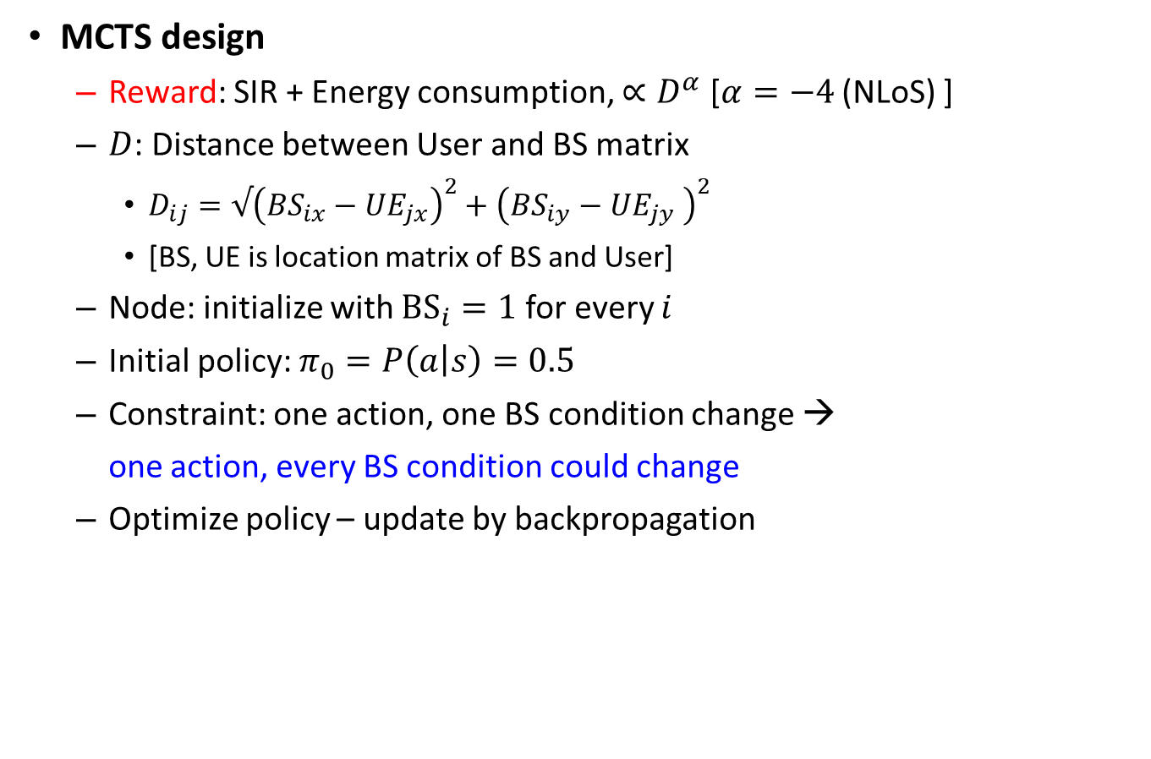
System Model
MCTS design
Reward: SIR + Energy consumption, $∝D^{α}$ [$α=−4$ (NLoS) ]
$D$: Distance between User and BS matrix
$D_{ij}=√{\left(BS_{ix}−UE_{jx}\right)}^{2}+{\left(BS_{iy}−UE_{jy} \right)}^{2}$
[BS, UE is location matrix of BS and User]
Node: initialize with ${BS}_{i}=1$ for every $i$
Initial policy: $π_{0}=P\left(a | s\right)=0.5$
Constraint: one action, one BS condition change →
one action, every BS condition could change
Optimize policy – update by backpropagation

Slide 5
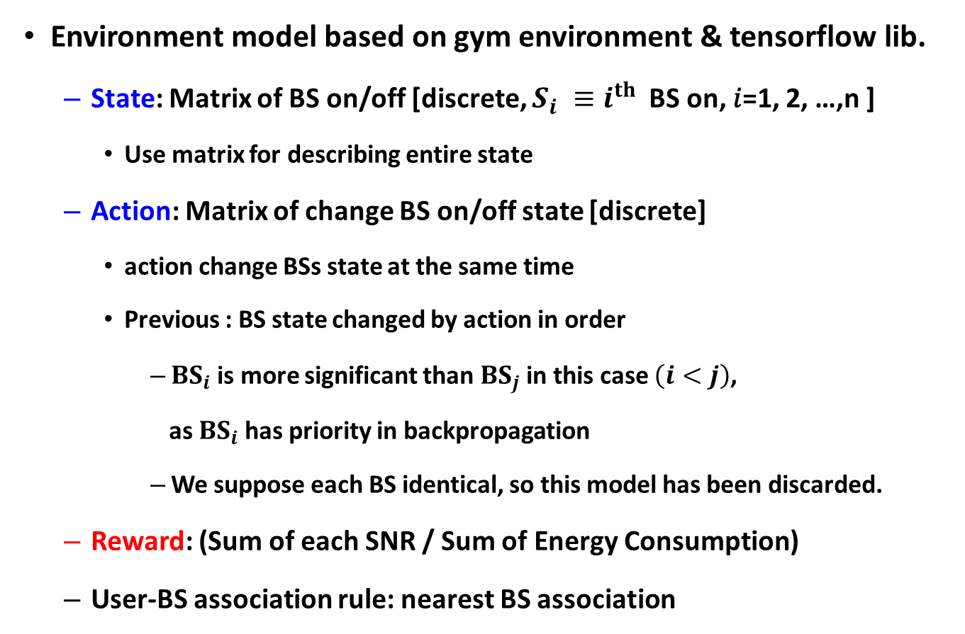
System Model
Environment model based on gym environment & tensorflow lib.
State: Matrix of BS on/off [discrete, $S_{i} ≡i^{th}$BS on, 𝑖=1, 2, …,n ]
Use matrix for describing entire state
Action: Matrix of change BS on/off state [discrete]
action change BSs state at the same time
Previous : BS state changed by action in order
${BS}_{i}$is more significant than ${BS}_{j}$ in this case $\left(i<j\right)$,
as ${BS}_{i}$has priority in backpropagation
We suppose each BS identical, so this model has been discarded.
Reward: (Sum of each SNR / Sum of Energy Consumption)
User-BS association rule: nearest BS association

Slide 6
System Model
Make 2 python module
main.py: UDNEnv(environment code)+MCTS(RL code)
ppp.py: create BSposition.csv(information of BS position)

Slide 7
System Model Structure
Class : UDNEnv
__init__ : Initialize parameters, BS position, depthLimit
Step : calculate Bsdistance/EnergyConsumption/SNR/reward
Initialize UE position(at every iteration)
Update State / Reward
Association : associate BS/UE by association rule
Binary convert : convert integer number to binary action
isTerminal : decide whether the state is terminal or not
Terminate when reach at
Return True/False
getPossibleAction : return list of every possibleaction
takeAction(action) : return the state according to action
getReward(action) : return the reward of specific state

Slide 8
System Model Structure
Class : mcts
__init__ : initialize parameters
search : search Tree until iterationlimit
executeRound : update node/reward, do backpropagate
selectNode : decide next node
expand : expand new node
Backpropagate : backpropagate the tree
getBestChild : find possible bestNodes
getAction : return action of bestnode

Slide 9
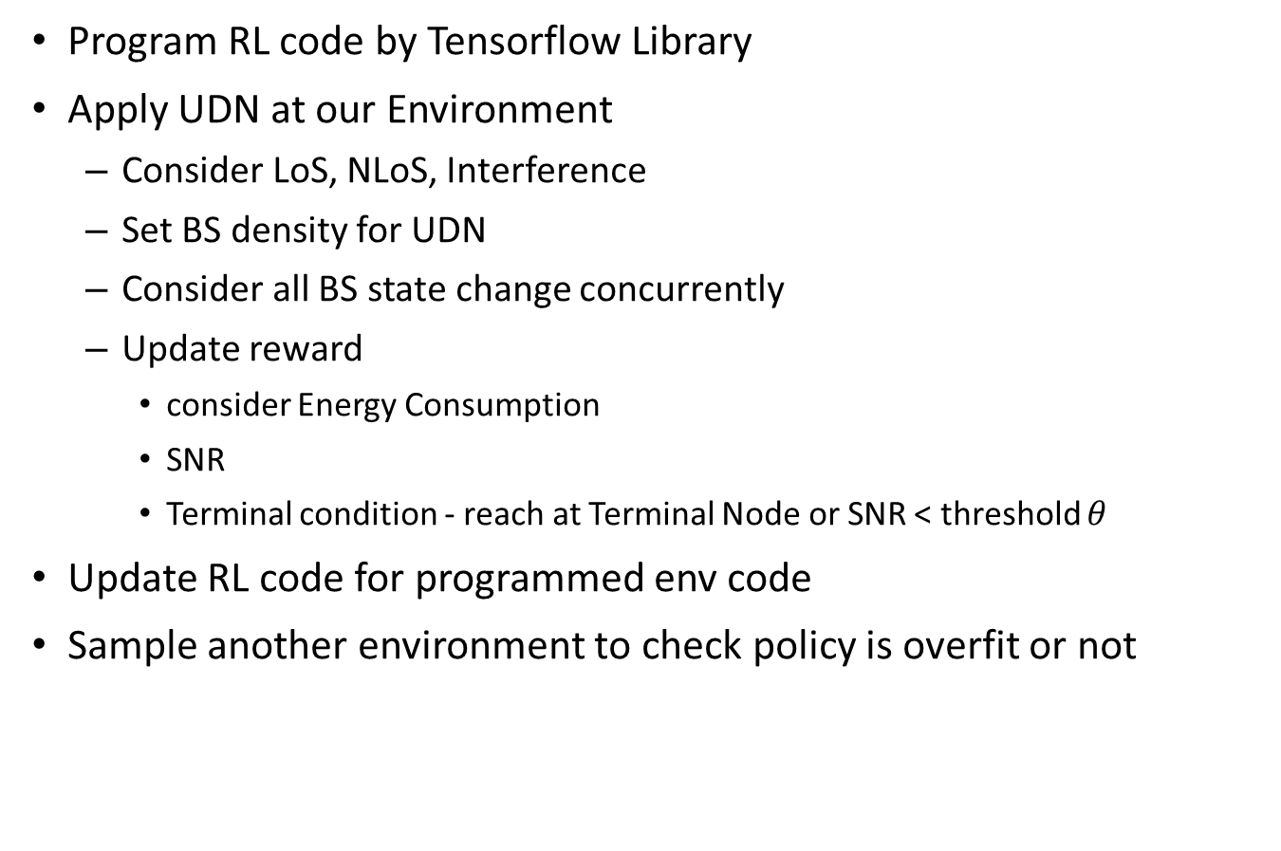
Future plan
Program RL code by Tensorflow Library
Apply UDN at our Environment
Consider LoS, NLoS, Interference
Set BS density for UDN
Consider all BS state change concurrently
Update reward
consider Energy Consumption
SNR
Terminal condition - reach at Terminal Node or SNR < threshold $θ$
Update RL code for programmed env code
Sample another environment to check policy is overfit or not

Slide 10
Thank you
Any Questions?

